Slide 1
明新科大2023年
上學期GPT(三)

Slide 2
課程大綱
ChatGPT Prompt介紹
人工智慧的奇點(Singularity)
OpenAI API開發

Slide 3
課程大綱
OpenAI介紹
ChatGPT介紹
神祕的GPT-4
生成模型的其它服務
大型語言模式
ChatGPT Prompt介紹
人工智慧的奇點(Singularity)

Slide 4
課程大綱
Prompt技法
Garbage in garbage out
Give enough examples
Role prompting
Zero shot
One shot
Few shot
Tone, length, structure
Chain of thoughts(simply add: let us think it step by step)
Use output as input to resample many times
OpenAI examples

Slide 5
課程大綱
OpenAI的API
Playground
Modes
Models
Temperature
Maximum length(4096, 8192(gpt4))
Stop sequences(A new line, the value “Human:”, and the value “AI:”. <|endoftext|>.
Top P
Top K
Frequency penalty
Presence penalty
Best of
Inject start text
Inject restart text
Show probabilities

Slide 6
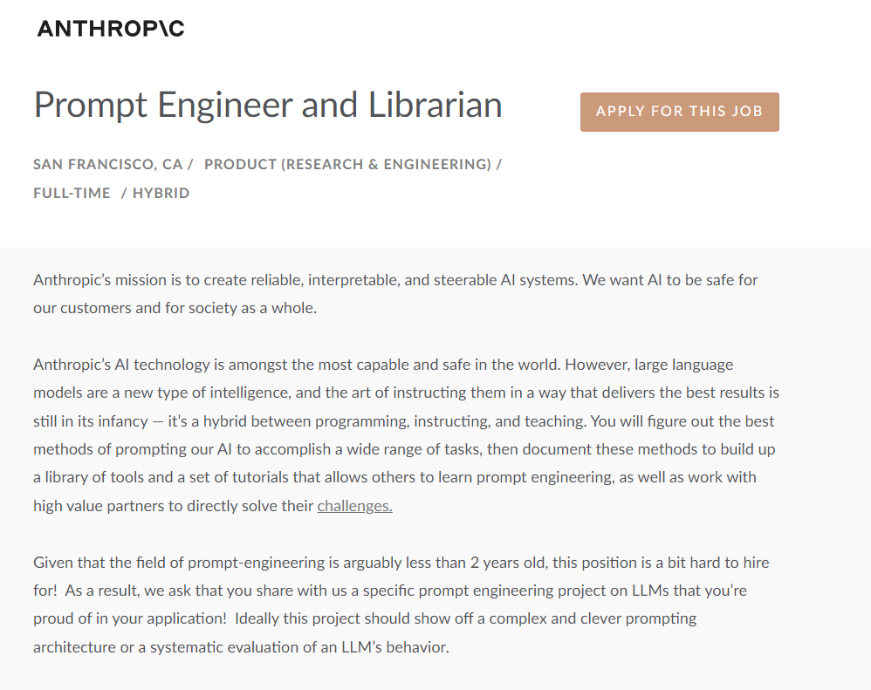

Slide 7
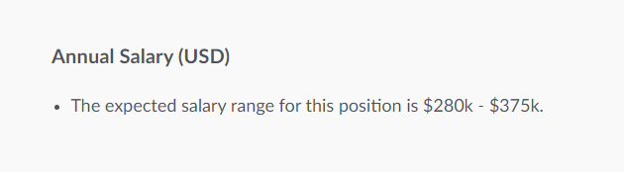

Slide 8
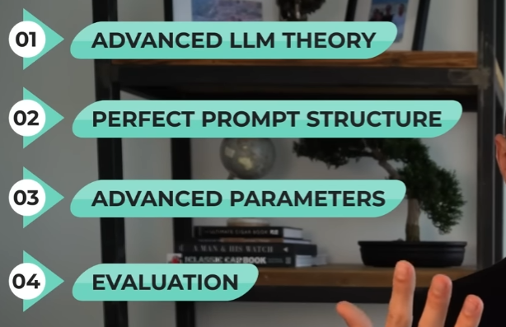

Slide 9
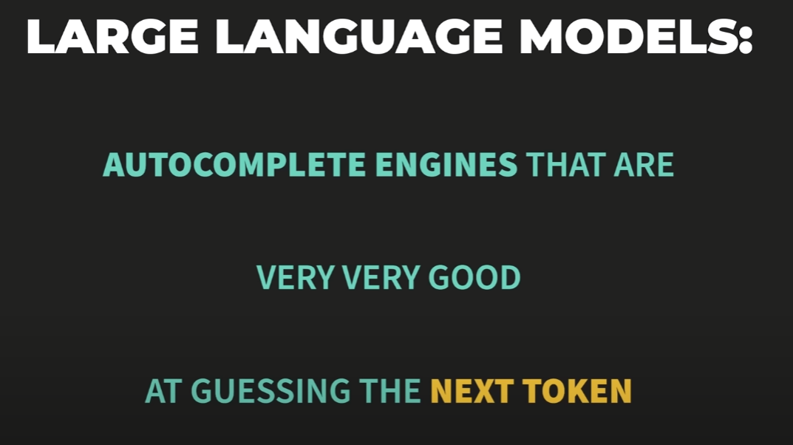

Slide 10


Slide 11


Slide 12


Slide 13
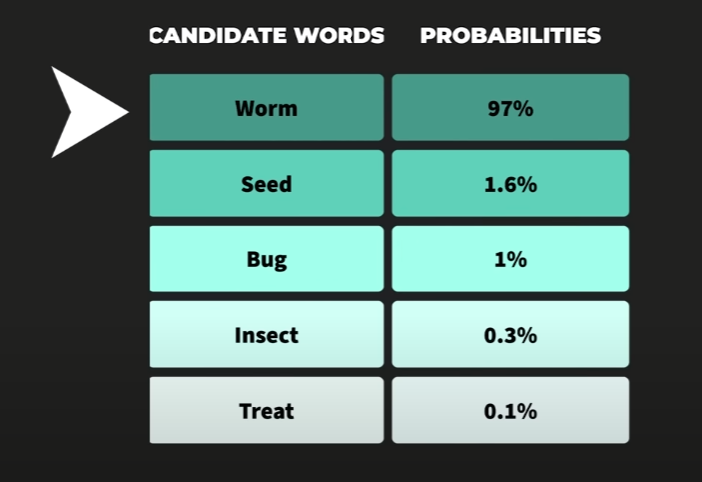

Slide 14
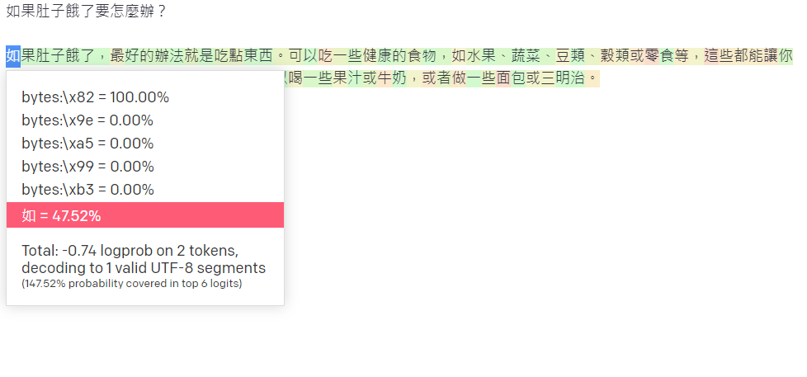

Slide 15
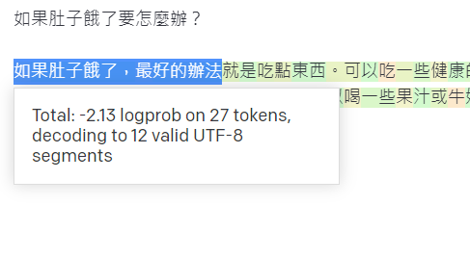

Slide 16
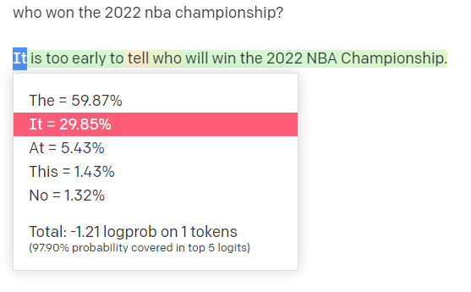

Slide 17
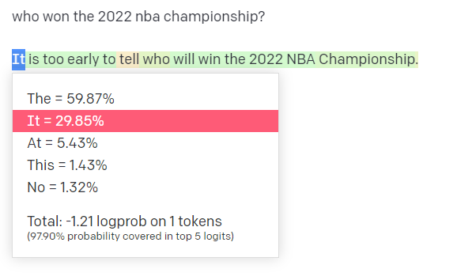

Slide 18
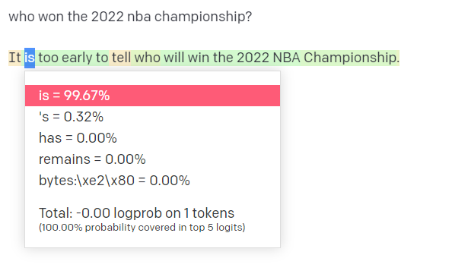

Slide 19
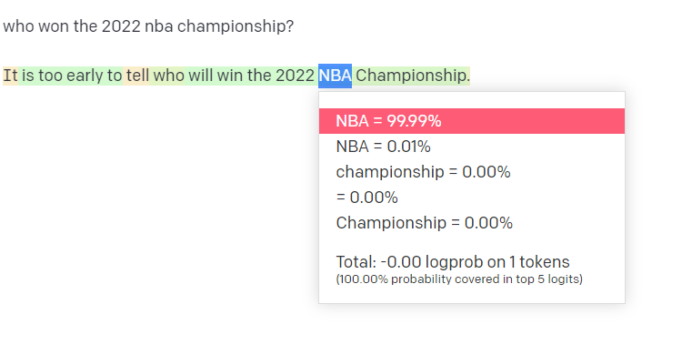

Slide 20
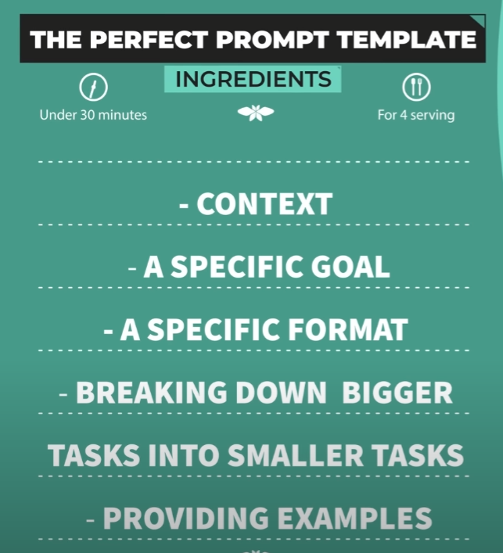

Slide 21
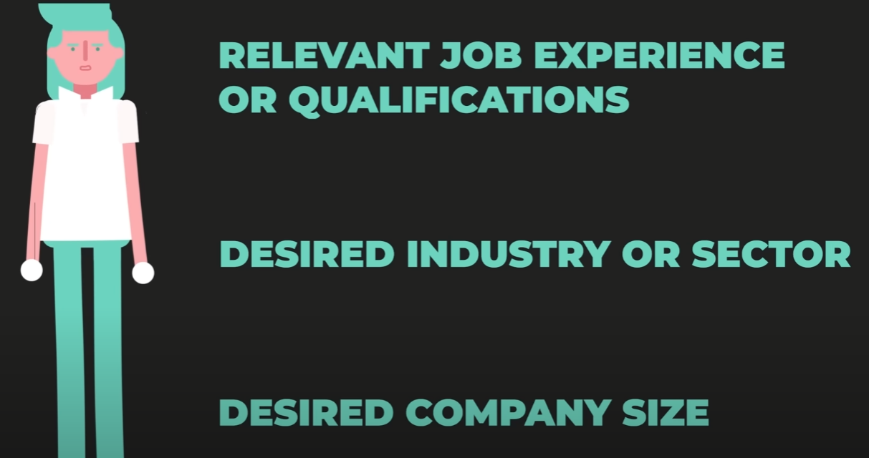

Slide 22


Slide 23
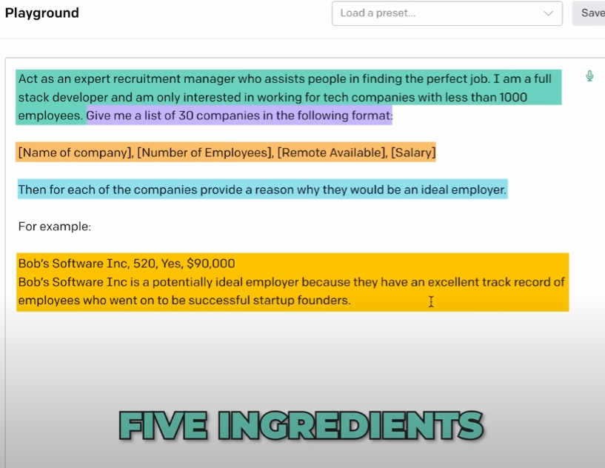

Slide 24
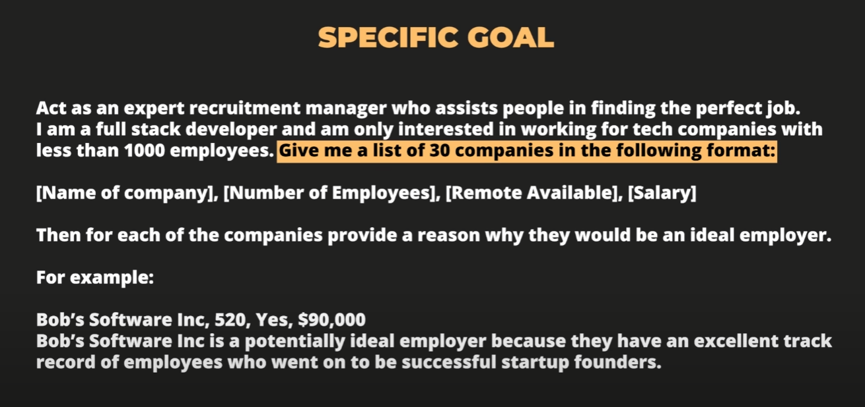

Slide 25
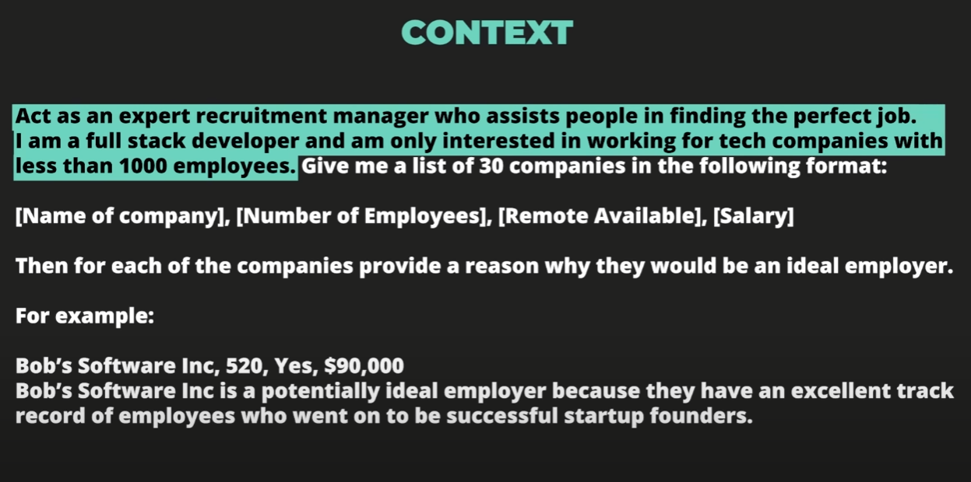

Slide 26
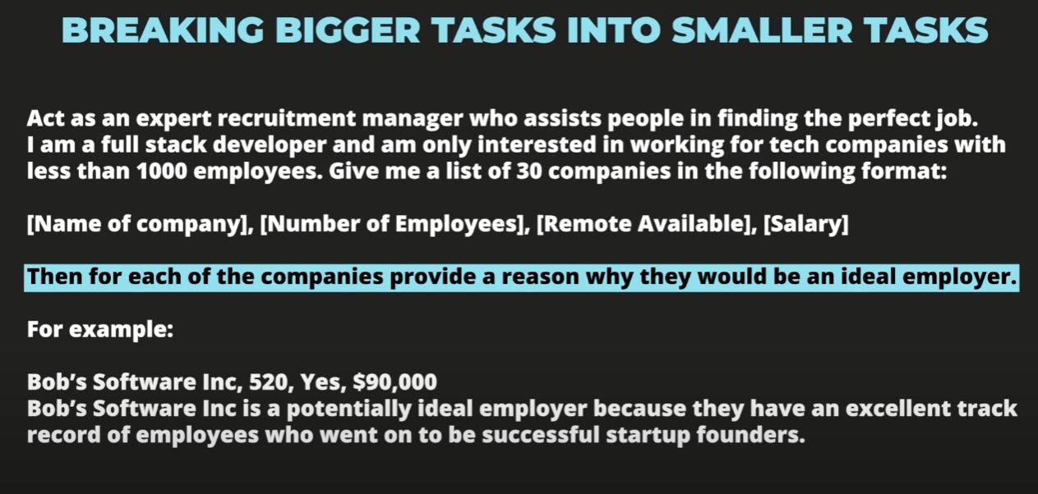

Slide 27
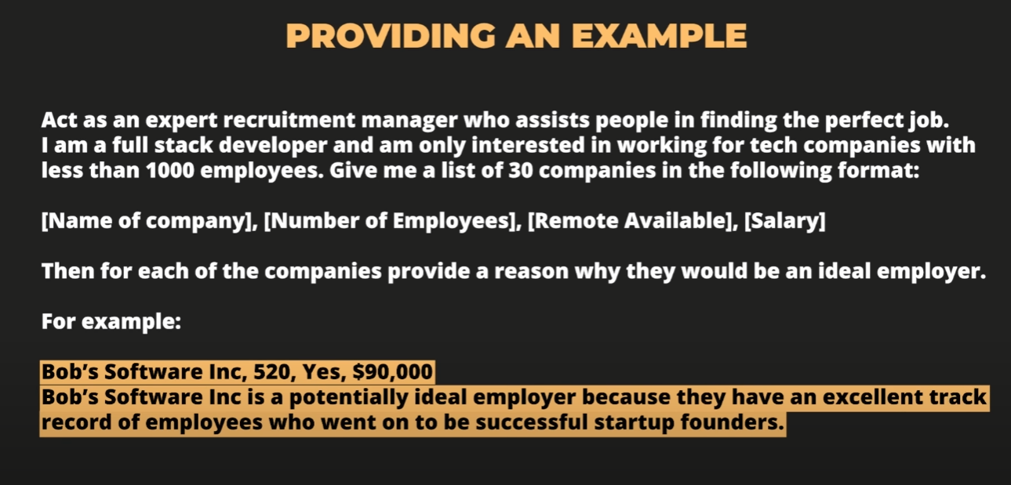

Slide 28


Slide 29
